Slide 1
analyze trends in incidence
and mortality of COVID-19 using python
Author - Kimaya Havle

Slide 2
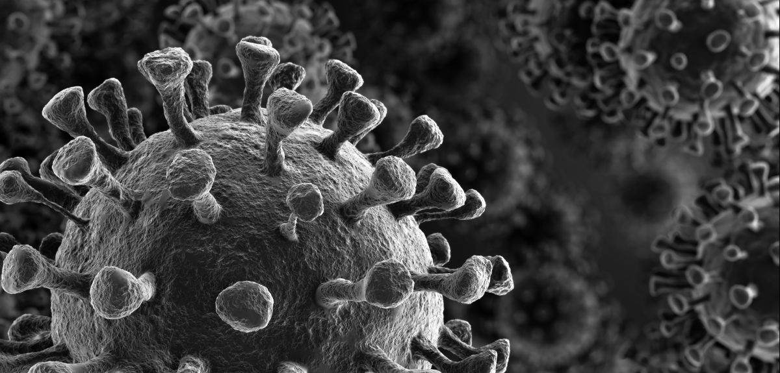


Introduction
COVID-19 has put the world on edge. Its high infectious rate has put patients at risk of critical condition and death. There has been an unprecedented influx of patients in hospitals, especially ICUs. This multitude of admissions exceeded the ICU bed capacities. Shortage of oxygen masks, Personal Protective Equipment (PPEs), hospital staff, and other hospital supplies led to numerous deaths. The rapid surge has led to a potential compromise and inconsistency in patient care quality.

Slide 3
Goal
The goal is use python to obtain trends in incidence and deaths due to COVID-19 which hospitals can use to be well-equipped and better prepare for treating patients and deliver quality care to every patient.
Stretch Goal
Perform predictions based on the trends using the “scikit learn” module

Slide 4
Overview of the project
Finding websites that provide COVID-19 data
Understanding the web page layout and finding the relevant table
Using BeautifulSoup module to scrape the data
Running the scraper every day for 7 days to build dataset
Storing that in CSV file
Reading the CSV data , cleaning and filtering it and creating a Pandas Dataframe
Re-modeling the Pandas Dataframe for visualization
Performing visualization using Seaborn module

Slide 5
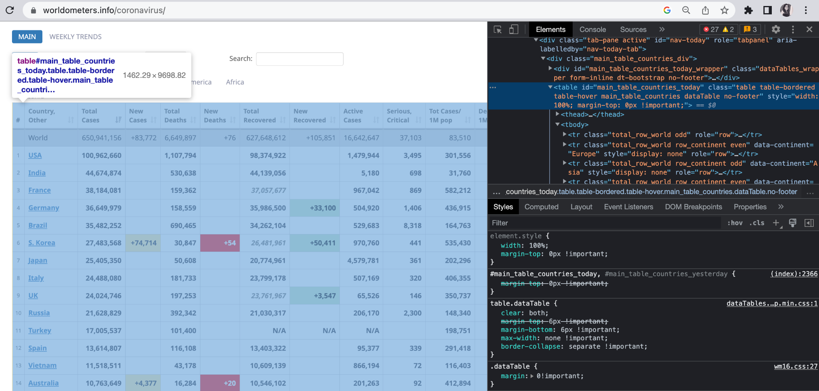
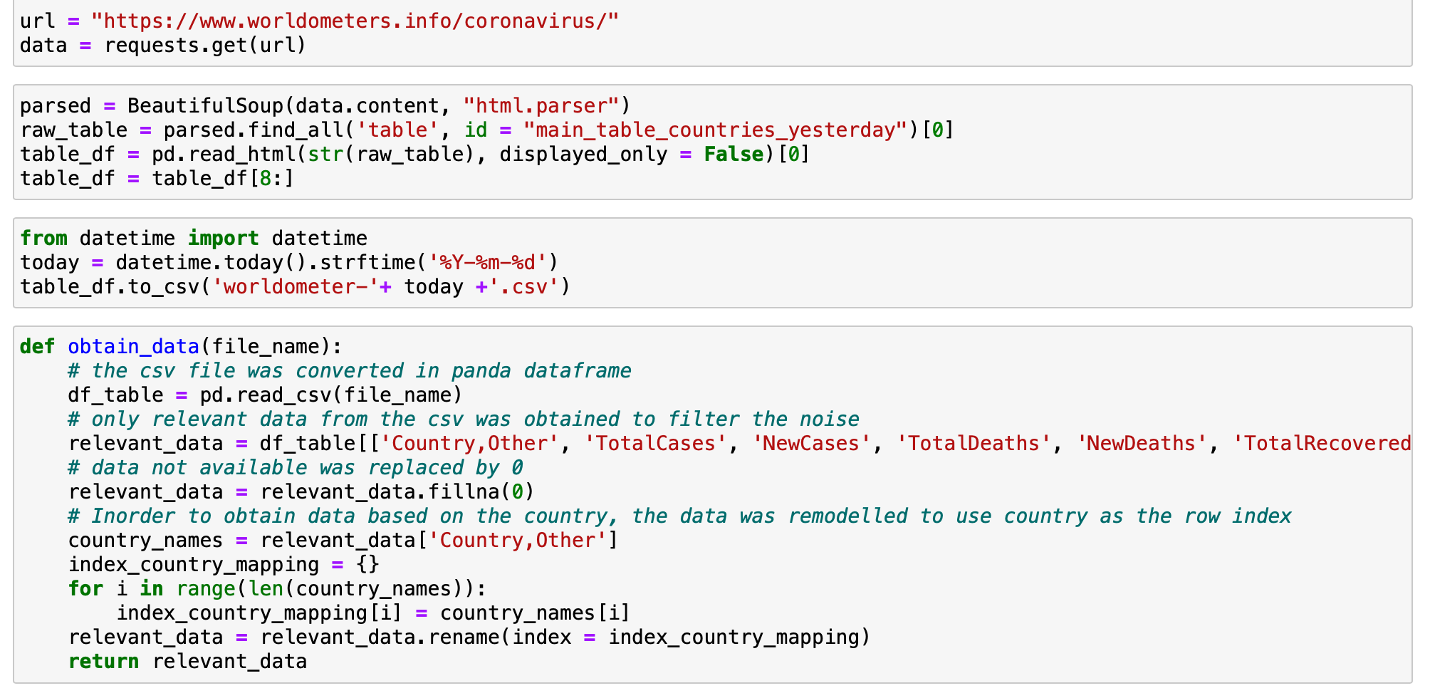
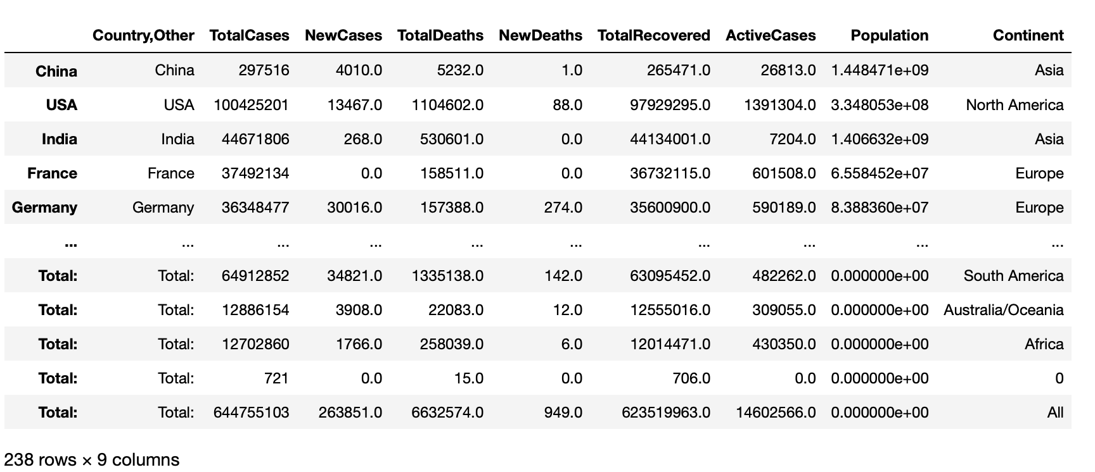
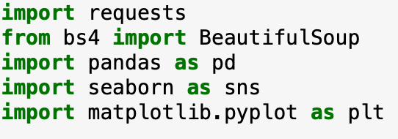
Inspecting world-o-meter html table
Challenging Part of the Project
DataFrame BUILT
Modules Used

Slide 6
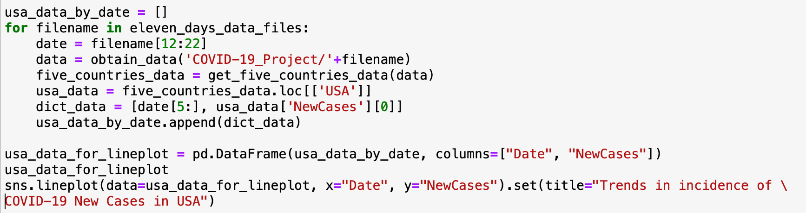
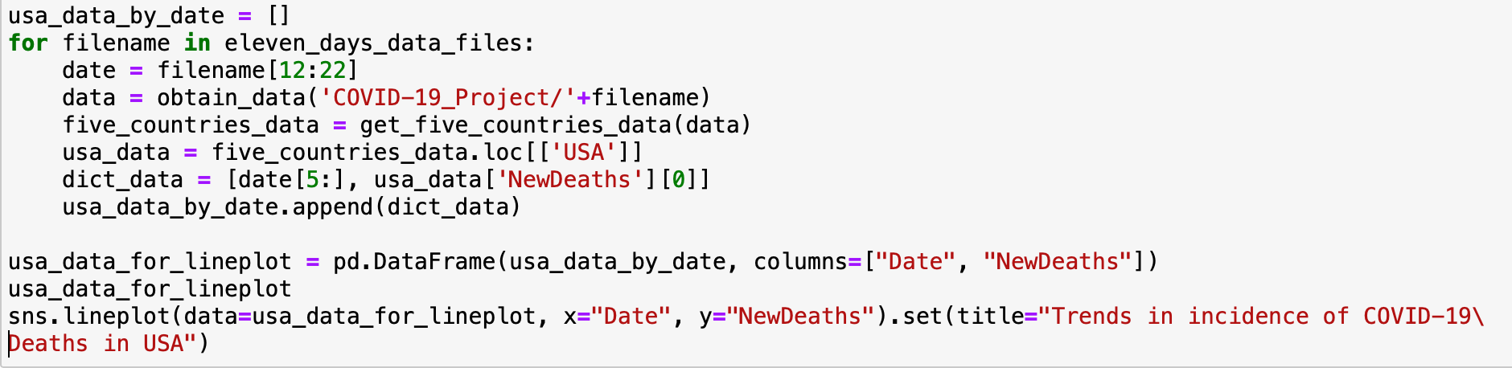
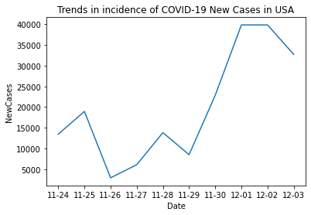
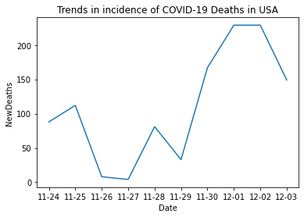
Trends in Incidence
Trends in DEATHS
t

Slide 7
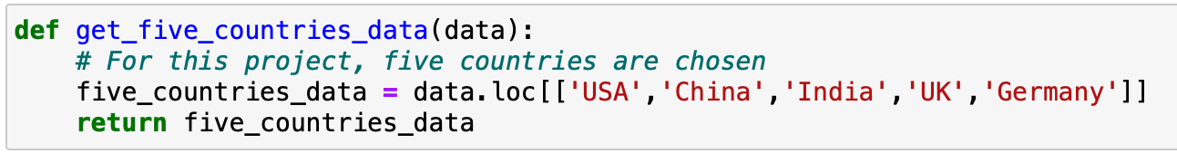
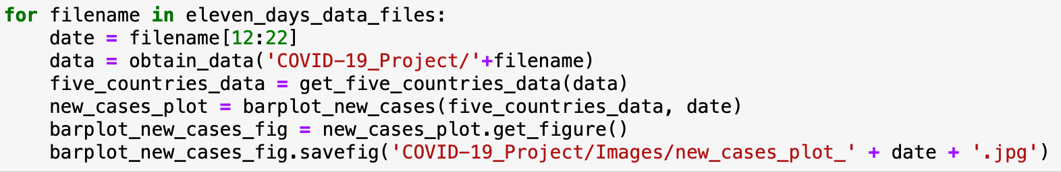
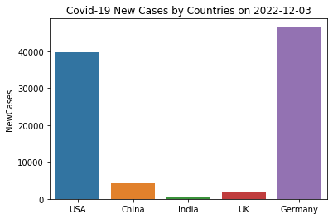
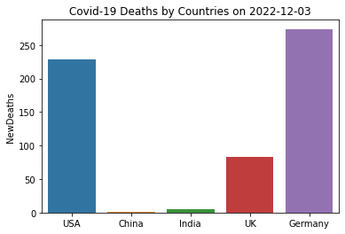
Trends in Incidence and Deaths for Five Countries
t

Slide 8
References:
https://link.springer.com/article/10.1186/s13613-020-00702-7
https://link.springer.com/article/10.1186/s13613-020-00702-7
Thank YOu

